Slide 1

CSE 515A
Software Engineering for Data Scientists
Visualization in Python
David Beck^{1,2}, Joseph Hellerstein^{1,3}, Jake VanderPlas^{1,4}
Jay Garlapatti³
¹eScience Institute
²Chemical Engineering
³Computer Science Engineering
⁴Astronomy
University of Washington
April 11, 2017

Slide 2
Agenda
Why visualize data?
Elements of visualization design
Python packages for visualization
In-class exercise
Beck, Hellerstein & VanderPlas, 2016

Slide 3
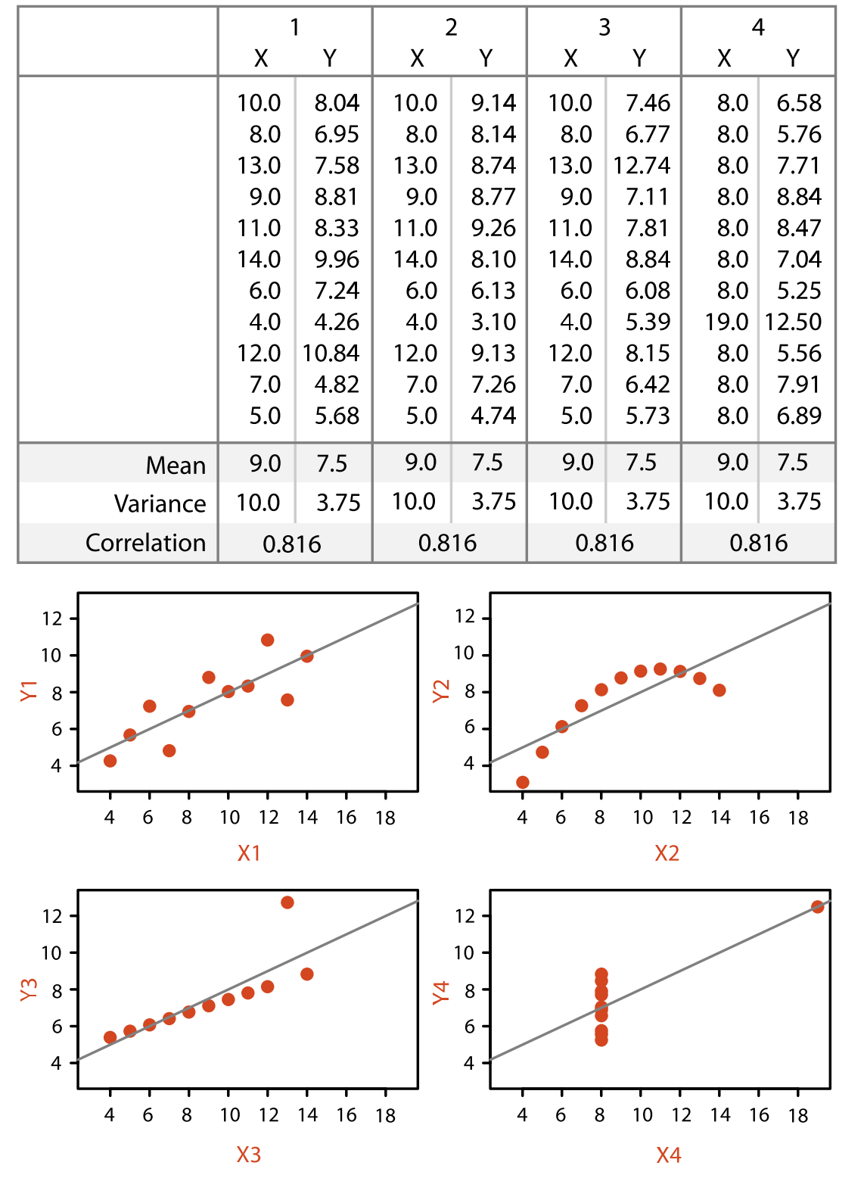
How do these data differ?
Beck, Hellerstein & VanderPlas, 2016

Slide 4
Why Visualize?
Discovery
Inference
Communication
Beck, Hellerstein & VanderPlas, 2016

Slide 5
Terminology in Visualization Design
Representation
  Environment for visualization (e.g., 2d, 3d, sound)
Idiom
  Constructs used (e.g., bar plot, area plot)
Task
  What the user is trying to do (e.g., compare, predict, find relationships)
Design
  How the idiom and representation are used to perform the task
Beck, Hellerstein & VanderPlas, 2016

Slide 6
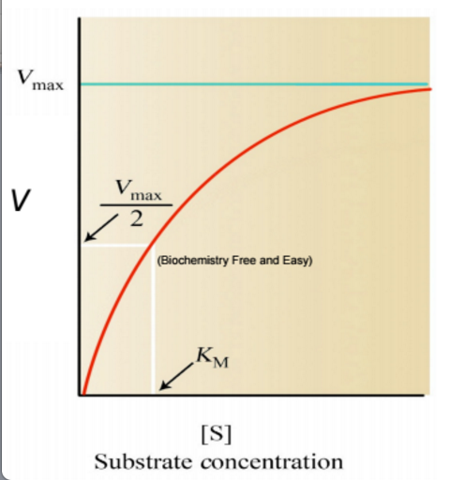
Example
Problem
  Which is the "best" enzyme to catalyze a reaction?
Measures of "best"
  V_{MAX} – the maximum reaction rate achieved using the enyzme
  K_{M} – the substrate concentration required to achieve half of the maximum reaction rate
Want large V_{MAX} and small K_{M}
Beck, Hellerstein & VanderPlas, 2016

Slide 7
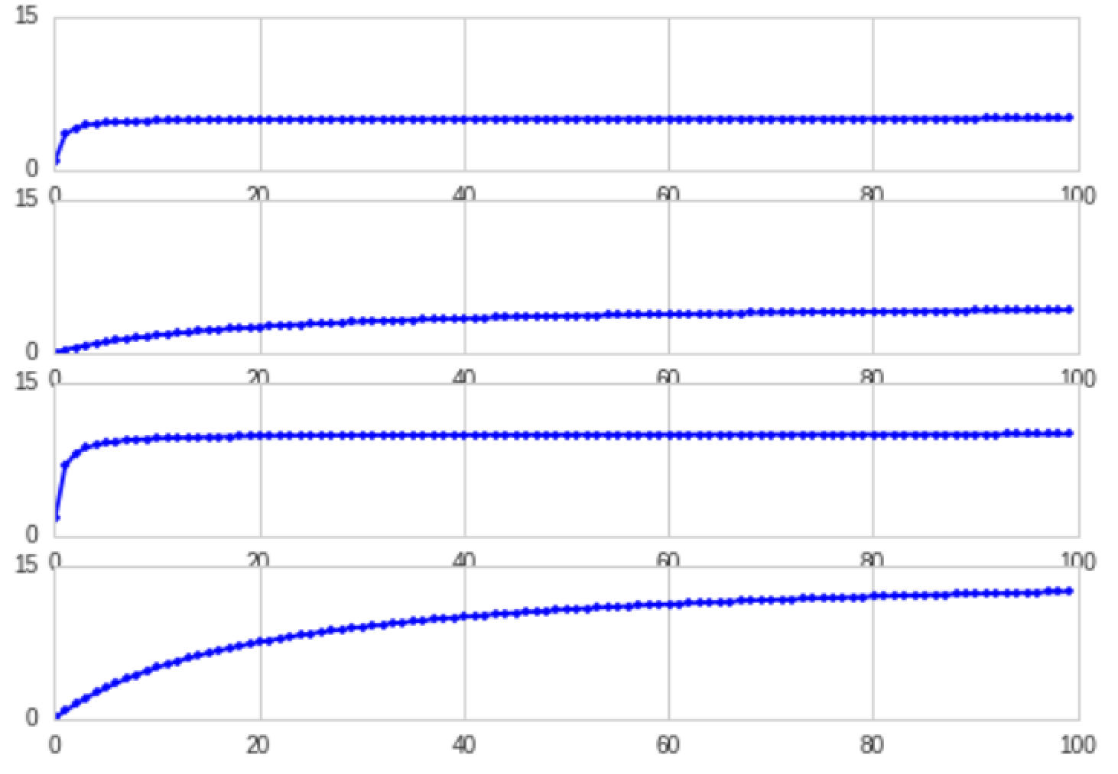
Which Enzyme is Best?
Want large V_{MAX} (high plateau) and small K_{M} (fast rise).
A
Difficult to tell from this visualization.
B
C
D
Beck, Hellerstein & VanderPlas, 2016

Slide 8
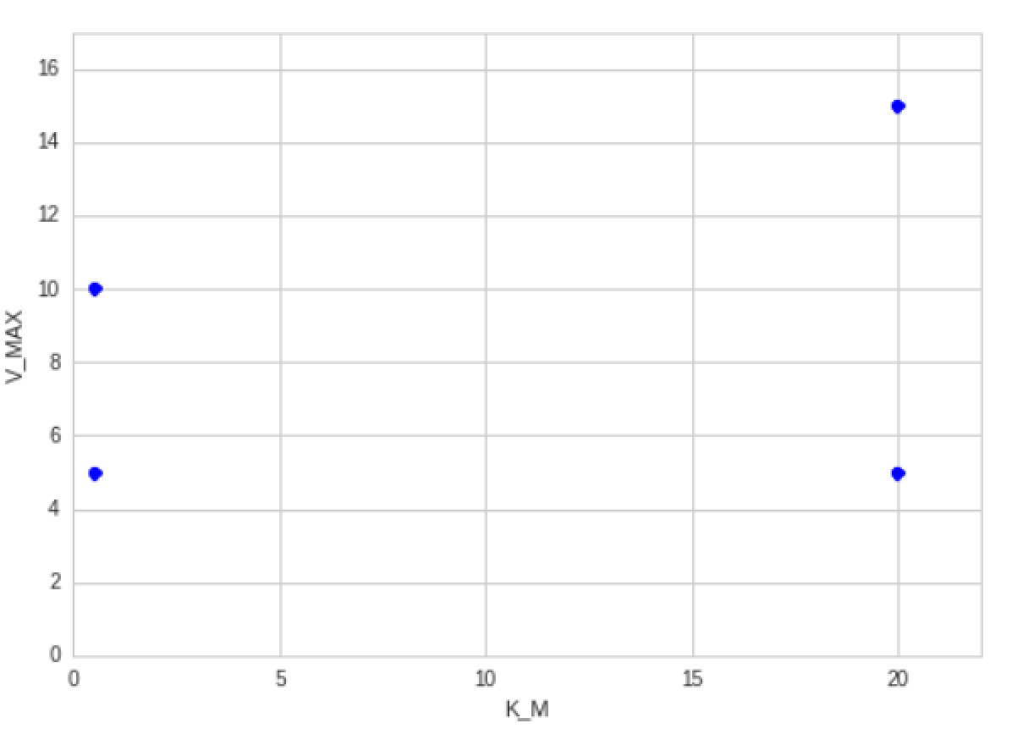
Other Visualizations
Want large V_{MAX} (high plateau) and small K_{M} (fast rise).
 | V_{MAX} | K_{M}
A | 5 | 0.5
B | 5 | 20
C | 10 | 0.5
D | 15 | 20
16
D
C
V_{MAX}
A
B
0
0
20
K_{M}
2-D comparison is difficult.
Use geometry to define "better than".
Beck, Hellerstein & VanderPlas, 2016
Notes:
Geometry of the relationships makes it easy to see which enzymes "dominate" in terms of the ordering of their values of Vmax and KM.

Slide 9
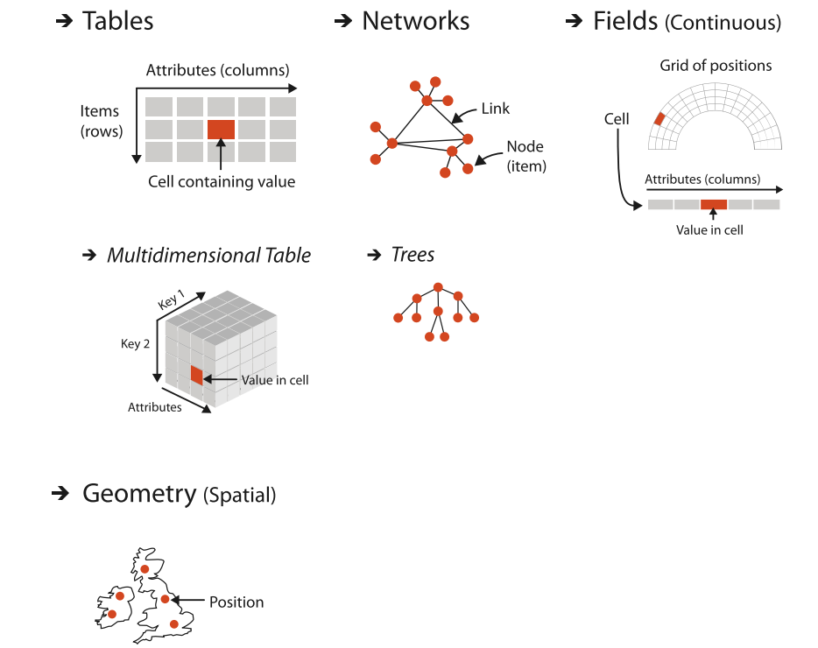
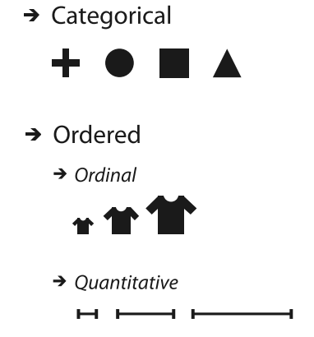
Data Characteristics & Visualization Design
Relationships Between Data Items
Data Values
Beck, Hellerstein & VanderPlas, 2016
Notes:
Looking for characteristics that easily map into a visual representation

Slide 10
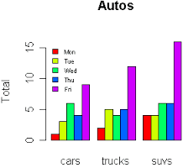
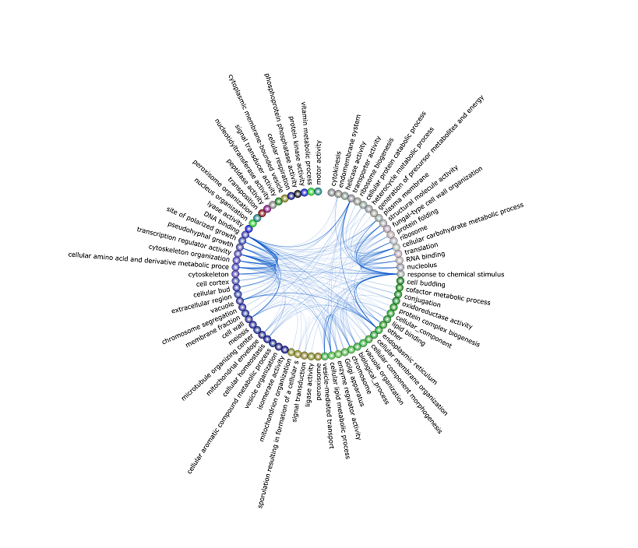
Tasks and Idioms
16
D
A
Comparison
Find "best" using multiple criteria
V_{MAX}
C
B
0
20
0
K_{M}
Trend
Find progressions (e.g., from small to large).
Relatedness
Find entities that are related by multiple criteria
Beck, Hellerstein & VanderPlas, 2016
Notes:
Expand each

Slide 11
Python Visualization Packages
matplotlib – MATLAB plotting in python
pandas – Visualization of pandas objects
seaborn – Statistical visualizations
bokeh – Interactive visualization using the browser
HoloViews – Simplified visualization of engineering/scientific data
VisPy – fast, scalable, simple interactive scientific visualization
Altair – declarative statistical visualization
Beck, Hellerstein & VanderPlas, 2016

